Slide 1

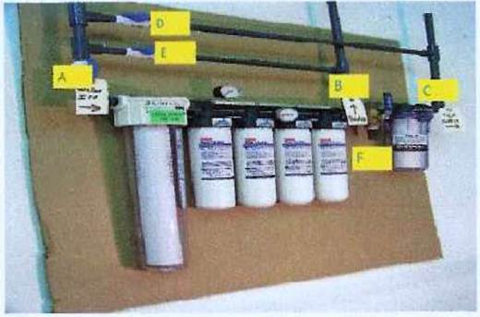
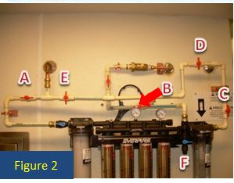
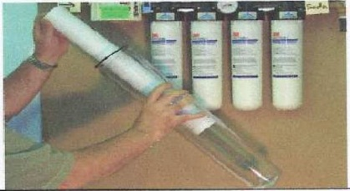
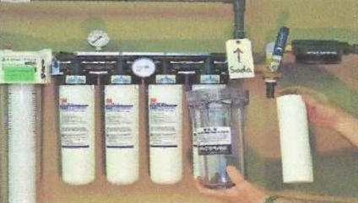
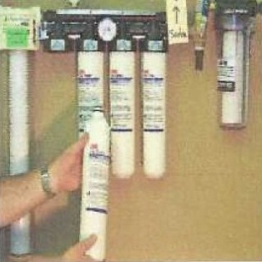

For Restaurants with Everpure High Flow CSR 9300 and 9400 Series Filter Systems
EQUIPMENT SERVICE INSTRUCTION
EVERPURE FILTRATION SYSTEM MAINTENANCE (ANNUAL)
NOTE: All Everpure cartridges are now being replaced with 3M cartridges.
Contact Strategic Equipment at (866)324-4253 Option #5
Turn water off to filtration unit (A,B &C). Open Bypass valves (D&E). Open Cartridge Flush valve (F). (See Figures 1&2)
Remove Pre-filter using sump wrench. Sanitize filter housing and filter bowl with green KAY-5 sanitizer. Lubricate and install new O-ring. Install new Pre-filter and hand tighten. (see Figure 3)
Remove SRX filter using sump wrench. Sanitize filter housing and filter bowl with green KAY-5 sanitizer. Lubricate and install new O-Ring. Install new 3M cartridge and hand tighten. (see Figure 4)
Remove each of the 4 carbon cartridges by turning ¼ turn left. Install the new CFS9112 cartridges by pressing up and turning ¼ turn right. Attach time strips and activate. (see Figure 5)
Open valve A slowly until fully open. Water will come out of valve F. Continue to flush through valve F for 4 full minutes. See if water is running clear. If not, keep flushing for another minute. When water from valve F is clear, shut valve F.
Open valves B&C. Close valves D&E. (see Figures 1&2)
If any leaks are detected at the Pre-filter bowl or the SRX feeder bowl, tighten slightly with the sump wrench.
Figure 1
Figure 3
Figure 4
Your Everpure filtration system is now back in service with new cartridges.
Figure 5
D&C Equipment June 2012

